Slide 1
Myers-Briggs Type Indicator MY Angular -project
N.SHASHIKANTH
19001180

Slide 2
Introduction
Welcome to our innovative personality testing application! Are you ready to uncover the fascinating facets of your personality and gain a deeper understanding of yourself? Our tool is designed to provide you with valuable insights into your unique blend of traits and tendencies, giving you the clarity and confidence to navigate life with greater ease. Whether you're a free spirit or a logical thinker, our application will help you discover the aspects of your personality that make you, well... you! So, let's get started – take the first step towards unlocking your full potential today

Slide 3
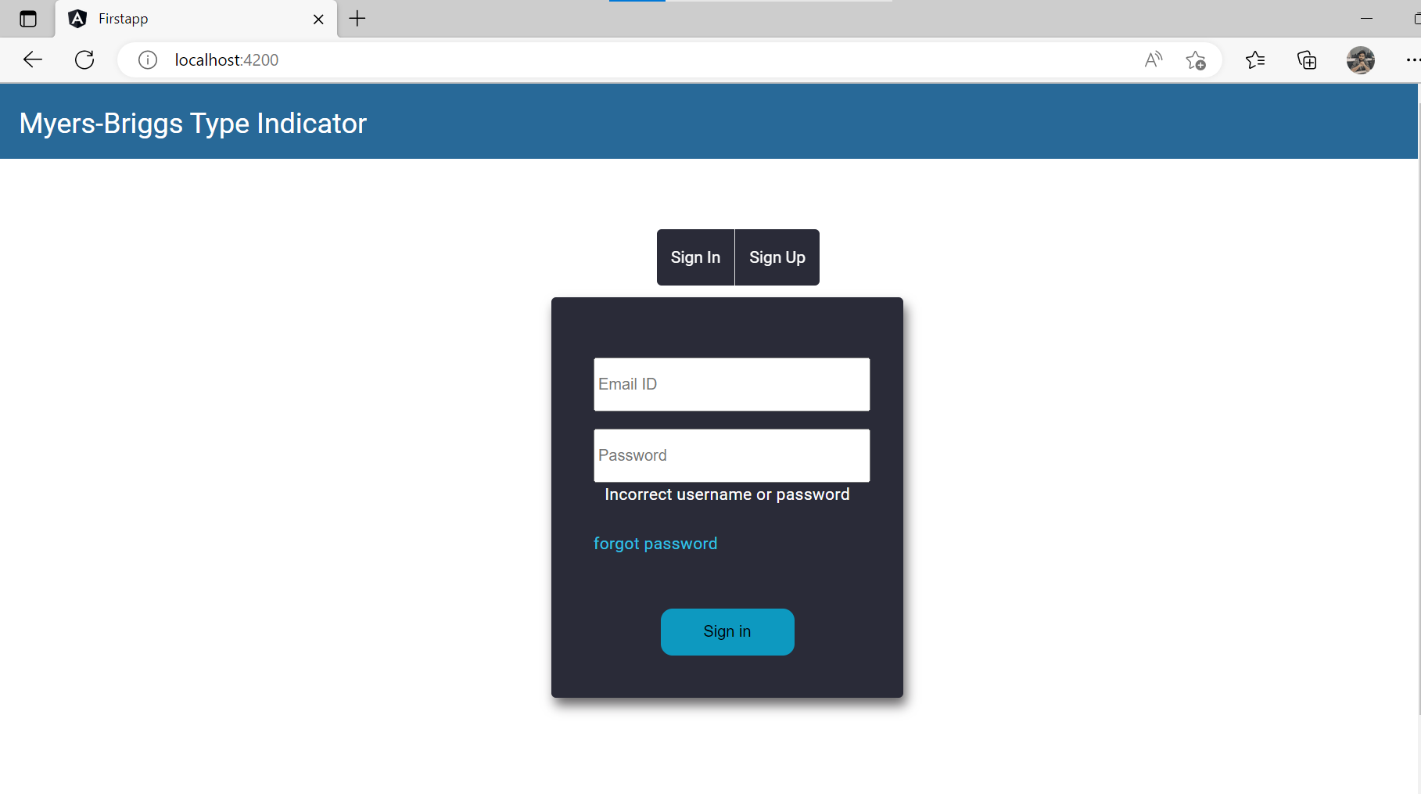
Login Page
Functionalities
SignIn
SignUp
Sign in button
Techniques used
Template based approach
Validation
Material Module
Toggle Function
Lazy loading
Http Get, post

Slide 4
USER SIDE IMPLEMENTATION

Slide 5
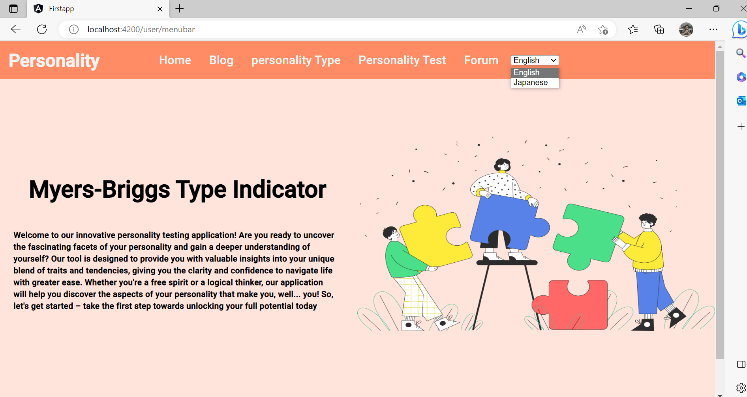
User – Menu bar
Functionalities
Language button
Home
Blog
Personality Type
Personality Test
Forum
Techniques used
i18N
Material module
Mat-toolbar

Slide 6
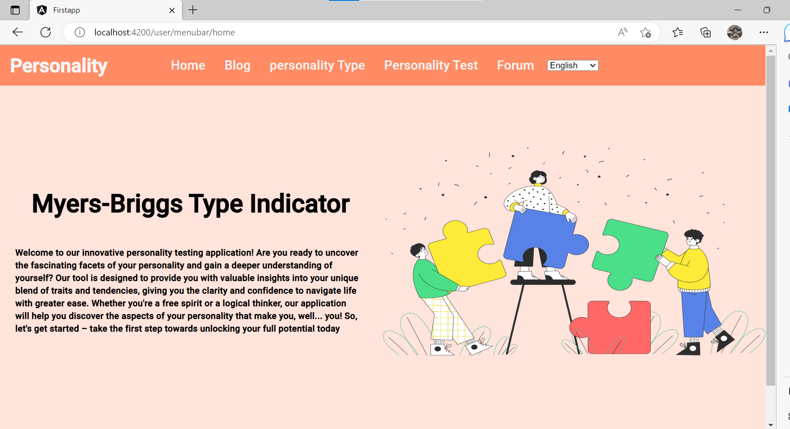
User - Home
Functionalities
Introduction about the web-application

Slide 7
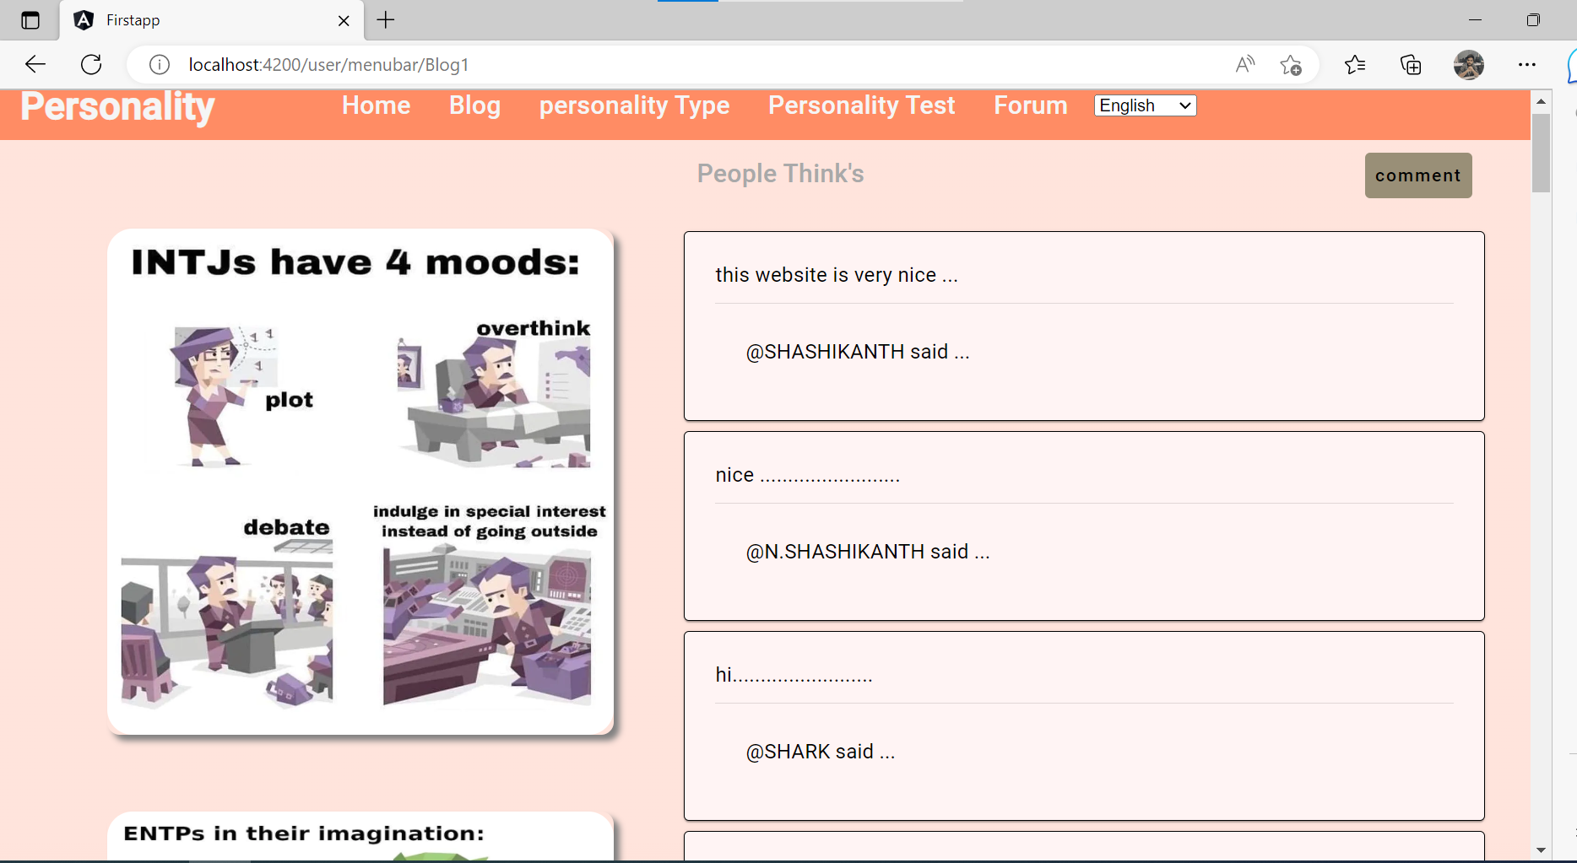
User – Blog
Functionalities
Memes image
Comment section
Techniques used
Routing parameters
Dialog
Material Module
Http Get method
Http post method
Used output directive for router navigation.

Slide 8
User – Blog- comment
Functionalities
Comment section
We can click comment section and add comment to page
Techniques used
Routing parameters
Dialog
Material Module
Http Get method
Http post method
Used output directive for router navigation.

Slide 9
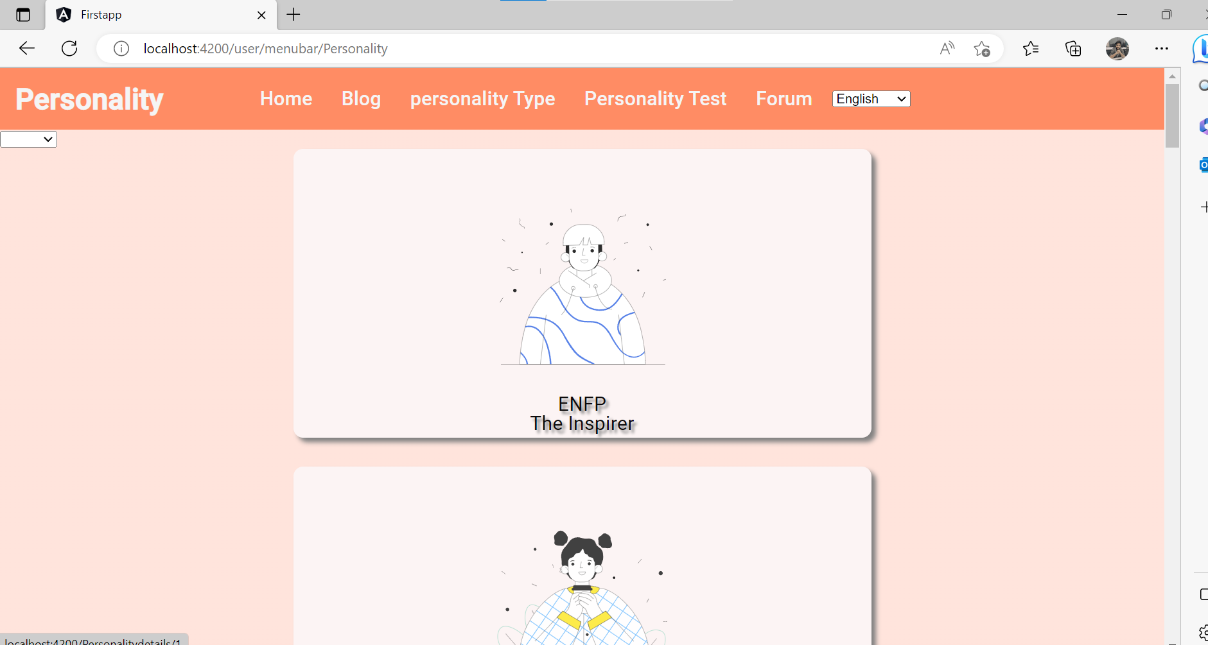
User –Personality Type
Functionalities
Pipe filter
16 personality types description –cards each personality
Techniques used
Routing parameters
Material Module
Http Get method
Http post method
Used output directive for router navigation.

Slide 10
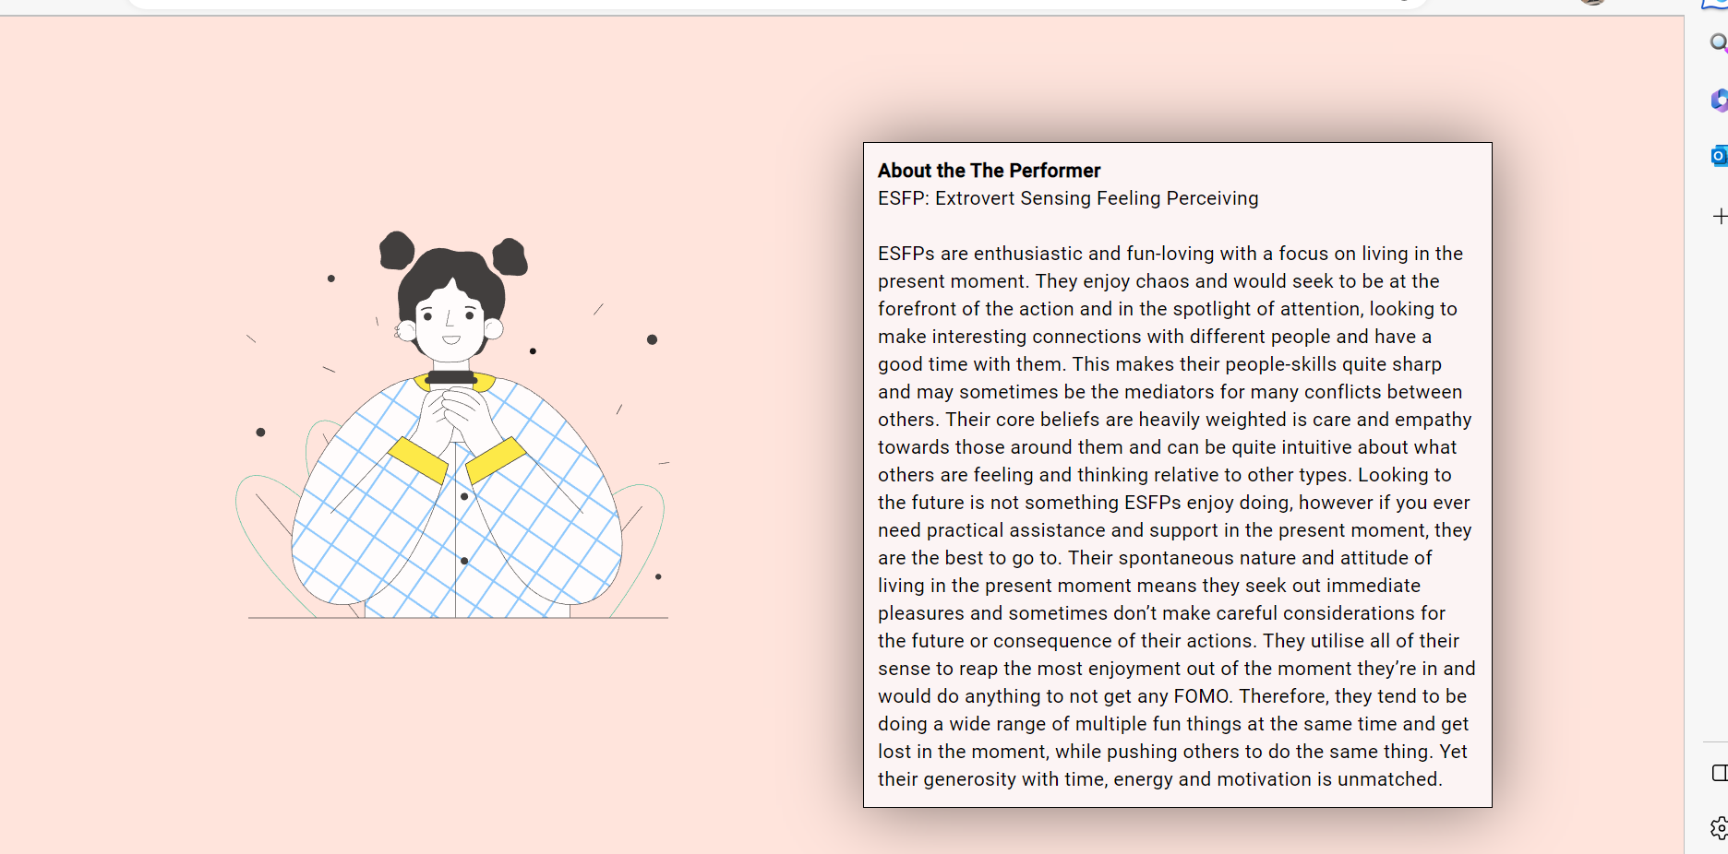
User –Personality Type - description –cards
Functionalities
16 personality types description –cards after clicking any one personality
Techniques used
Routing parameters
Material Module
Http post method
Used output directive for router navigation.

Slide 11
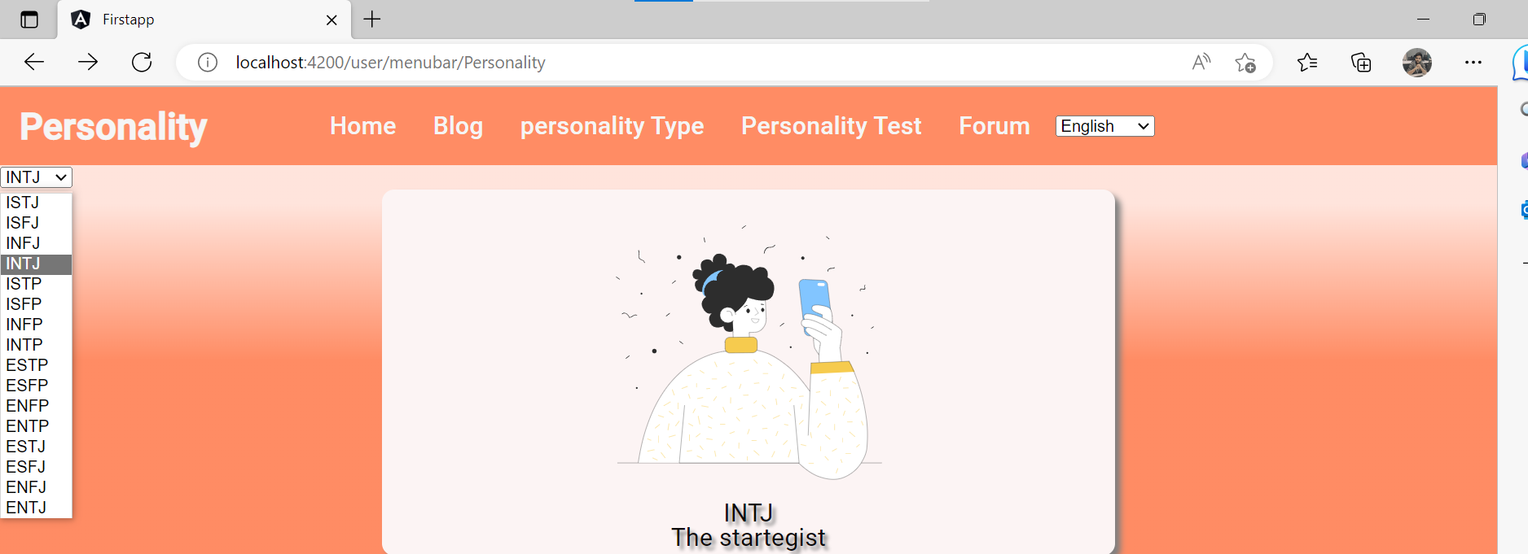
User –Personality Type - pipes
Functionalities
Pipe filter 16 personality types description –cards. Pipe is used to sort each personality
Techniques used
Routing parameters
pipes
Material Module
Http post method
Http get method
Used output directive for router navigation.
services

Slide 12
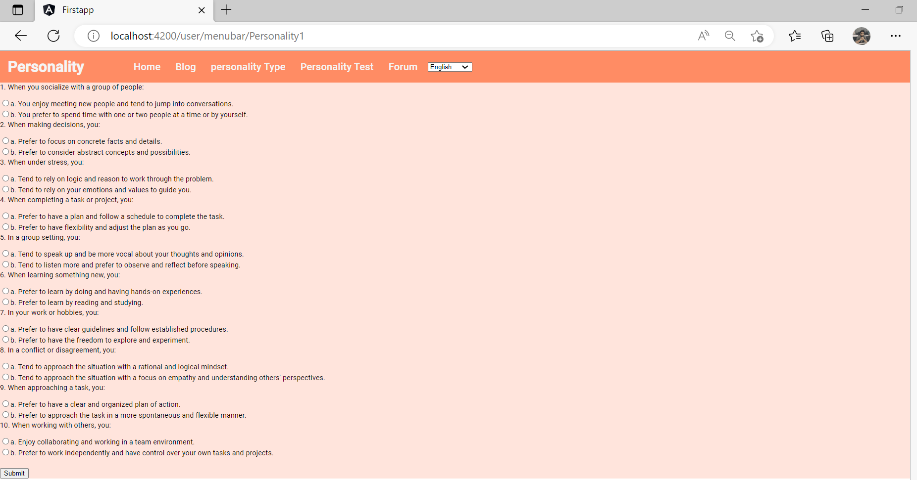
User –Personality Test
Functionalities
personality test
10 question based on that question personality type will display
Submit button
Techniques used
Routing parameters
Used output directive for router navigation.
Reactive Forms Module
Model based approach
Form validation
Structural Directives : *ngIf , *ngFor

Slide 13
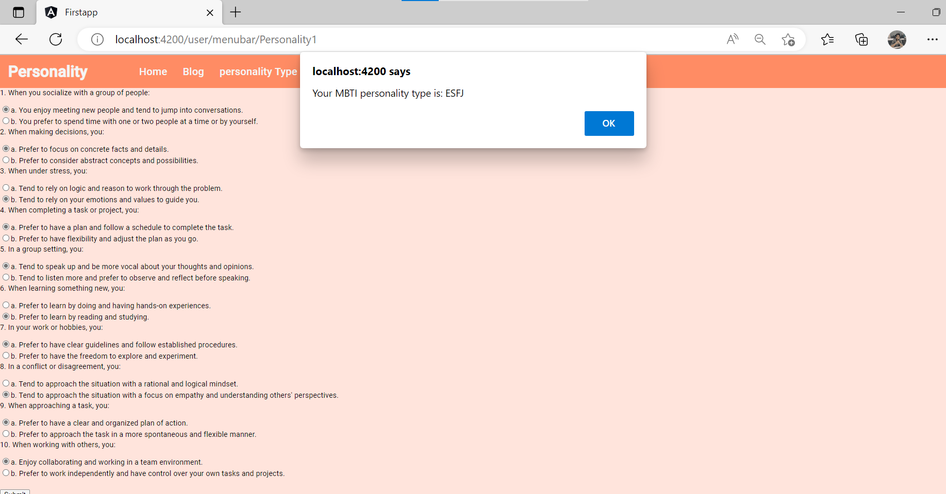
User –Personality Test
Functionalities
Alert box with personality type based on form validation
Techniques used
Routing parameters
Used output directive for router navigation.
Reactive Forms Module
Model based approach
Form validation
Structural Directives : *ngIf , *ngFor

Slide 14
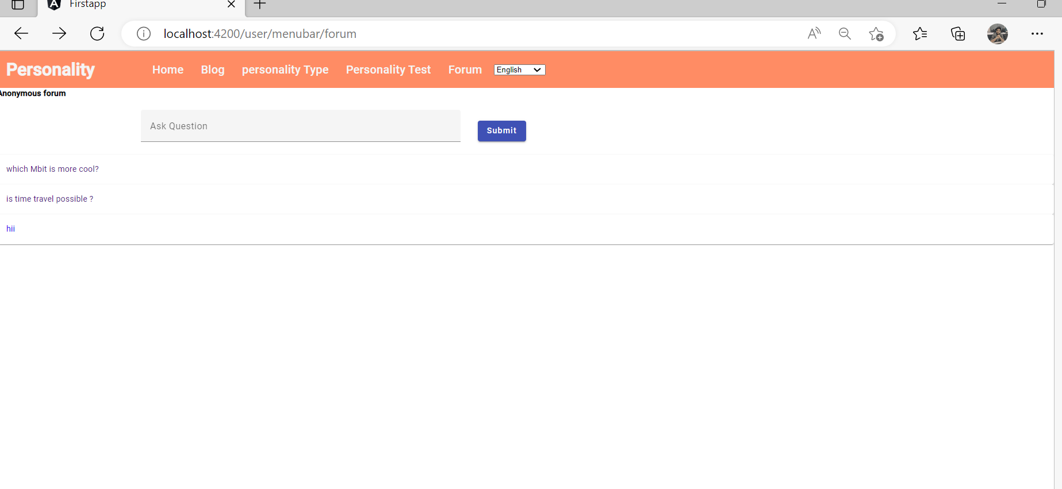
User -Forum
Functionalities
Question input box
Submit button
Techniques used
Routing parameters
Used output directive for router navigation.
Reactive Forms Module
Material Module
Http Get method
Http post method
Used output directive for router navigation.

Slide 15
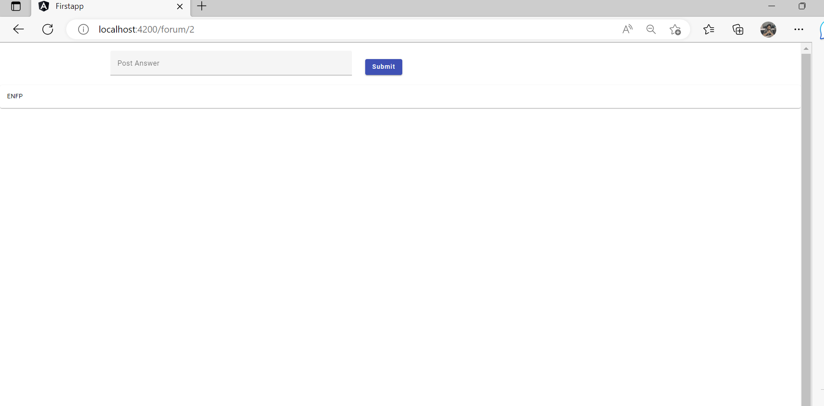
User –Forum response
Functionalities
Answer input box
Submit button
Techniques used
Routing parameters
Used output directive for router navigation.
Reactive Forms Module
Material Module
Http Get method
Http post method
Used output directive for router navigation.

Slide 16
User –Personality Test
Functionalities
Alert box with personality type based on form validation
Techniques used
Routing parameters
Used output directive for router navigation.
Reactive Forms Module
Model based approach
Form validation

Slide 17
ADMIN SIDE IMPLEMENTATION

Slide 18
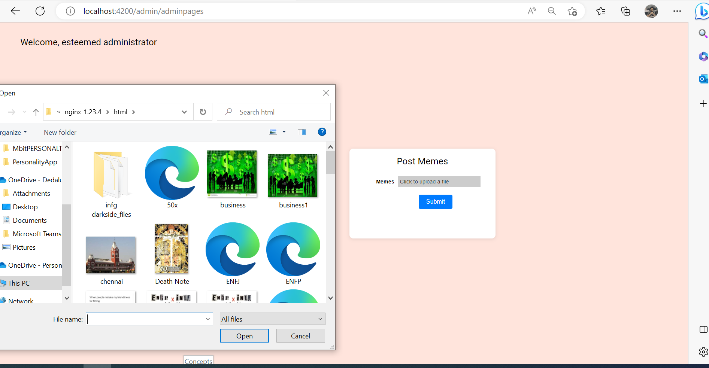
Admin page
Functionalities
Post Memes we can select memes from the laptop
Submit button
That meme can reflect in blog page
Techniques used
Routing parameters
Http post method
Used output directive for router navigation.
Service
Material Module

Slide 19
Concepts
Implemented
Not - Implemented
Used Component Hierarchy
Used services
Used pipes
For UI components, used angular material
Data maintained in Json-server API
Used Routing parameters
Implemented Lazy loading
Used both Template based & Model based approach
Implemented Multiple user flow
Effective handling of multiple modules
Internationalization
Complex feature implementation
Security implementation
Custom directives

Slide 20
THANK YOU

